Slide 1
Dicision Maker
Choose A or B, GOD give you Answer.
Team 01. Nam Se Hyun

Slide 2
Dicision Maker
Data is not only composed of words.
Picture
Sound, Feeling, e.t.c.
Making query is very hard.
Because Search Engine is not Human.
People has Limit of words in common life.
We need something more Easy Searching Tool.
Or Querying Tool.

Slide 3
The Main Idea
Find words and Making query is hard.
But Choose 1 between 2 is Easy.
Step by Step
We don’t have to find something at one time.
But Search Engine dosen’t care about our wrong query.
So
Choose 1 bettwen 2
Continuously
Then I will give you the ANSWER.

Slide 4
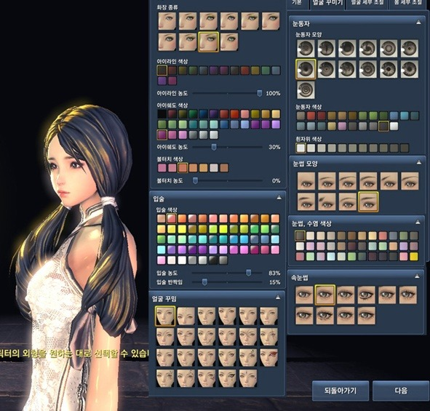
Why it works?
The Difference
If ( A == B ) => false → A has a difference from B.
A might has relevant point
B might has non-relevant point
The Algorithm Will Guess
Which point is relevant and non-relevant
With continuous question.
Ex) Character Customizing System on Video Game.

Slide 5
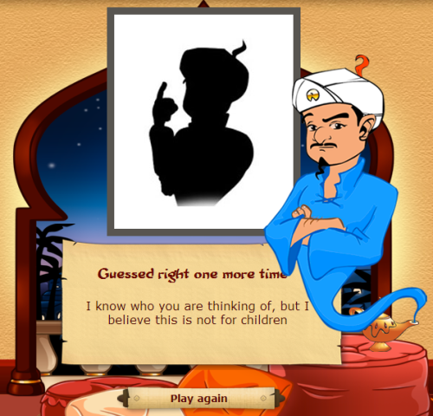
It is similar with ...
- Akinator
But
This Project’s Objective
Providing Document and Example.
To let other developer try developing
To give user new better searching experience.

